Slide 1

Data Wrangling in R & the tidyverse
Psych 741: Hierarchical Linear Modeling

Slide 2
Overview of Tutorial Slides
Intro to the tidyverse (slides 3-9)
Data Wrangling
Data Transformations (slides 11-19)
Reshaping Data (slides 20-33)
Merging Data (slides 34-46)

Slide 3
Introduction to the tidyverse

Slide 4
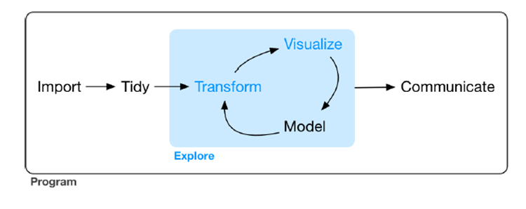
The tidyverse
Developed by Hadley Wickham
Collection of packages constructed to "share an underlying design philosophy, grammar, and data structures"

Slide 5

tidyverse Main Packages
*These packages can be loaded individually or all together by loading tidyverse

Slide 6
Tidy data
Tidy data consists of a data set with the following three requirements:
Every column is a variable
Every row is an observation/participant/unit
Every cell is a single value
Data that are not tidy are considered messy. Messy data can derive from many reasons or sources.
Examples???

Slide 7
Intro to some useful dplyr functions
mutate()
Add, modify, or remove columns of data
filter()
Subset the rows of data based on column/variable values
select()
Subset the columns of data based on column names or types
group_by()
If you wish to group certain rows together based on column/variable values
summarize()
Provide summary/descriptive values for column(s) in the data set

Slide 8

The pipe operator %>%
Can be used to perform operations sequentially without having to define intermediate objects.
The object or result from the left of the %>% automatically gets “passed on” to the expression to the right of the operator

Slide 9


The pipe operator %>%
Example:
Can produce cleaner and less error-prone code than other traditional methods:

Slide 10

Data Wrangling

Slide 11
Data Transformations

Slide 12
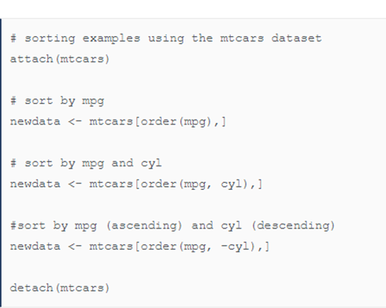
Sorting Data
The order() function in base-R can be used to easily sort data in a data file based on one or multiple variables/columns
The arrange() function in tidyverse can be used
Example: arrange(mtcars, mpg, cyl)

Slide 13
Changing Column Names
Base-R
The colnames() function can be used.
Example: colnames(df)[column_num] <- "new_column_name"
Example: colnames(df)[which(names(df) == "col1")] <- "new_col1"
tidyverse
Use the rename() function
Example: rename(df, new_variable_name = old_variable_name)
Use the rename_with() function if you want to apply a function to column names
Example: rename_with(df, tolower)
Example: rename_with(df, ~paste0(., "_Wave1 "))

Slide 14
Creating Scale Scores
The rowMeans() and rowSums() functions can be used to calculate mean and total scores
Example: rowMeans(df[,5:10])
Example: rowSums(df[,c(‘variable1’, ‘variable2’, ‘variable3’)])
If missing data is present for some participants, na.rm = TRUE would need to be added to the above functions
If missing data present, and all items are on the same response scale, mean scale scores are preferred.
Why???

Slide 15
Recoding Variables
Very common that you need to recode the values of a variable, including:
Reverse scoring an item/scale/index
Dummy coding variables
Dichotomizing a continuous variable based on a clinical cutoff
Grouping together values/categories
Converting strings/characters to numbers (or vice versa)
Recoding into a new variable based on responses across multiple variables
Others???

Slide 16
Recoding Variables – base-R
Values can be directly recoded
Example into the same variable: df$var1[df$var1 == -999] <- NA
Example into a new variable: df$new_var1[df$var1 == -999] <- NA

Slide 17
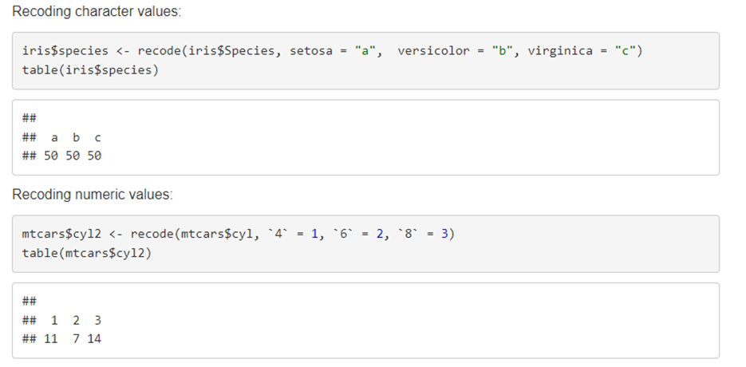
Recoding Variables – tidyverse
The recode() function can be used to recode values on a variable
The .default argument can be used to recode any additional values/categories to a particular new value

Slide 18
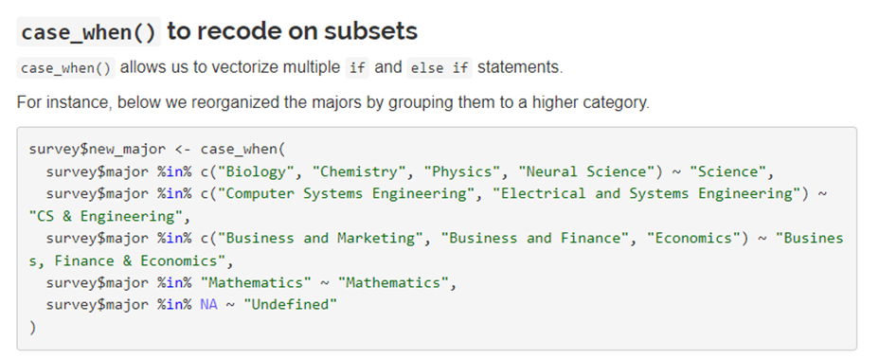
Recoding Variables – tidyverse
The case_when() function is useful when you want to group together many categories/values together

Slide 19
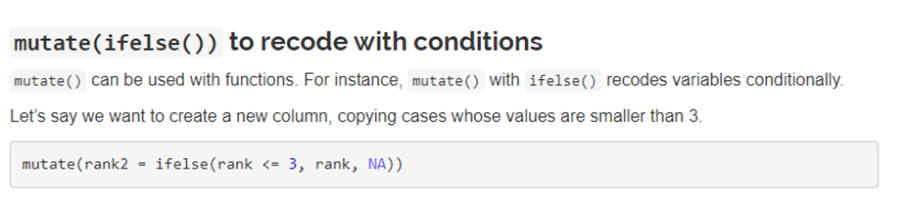
Recoding Variables – tidyverse
Functions can be incorporated into the mutate() function

Slide 20
Reshaping Data

Slide 21
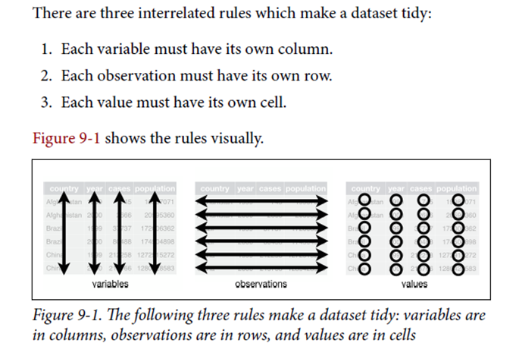
A review of tidy data
From Wickham & Grolemund (2017)

Slide 22
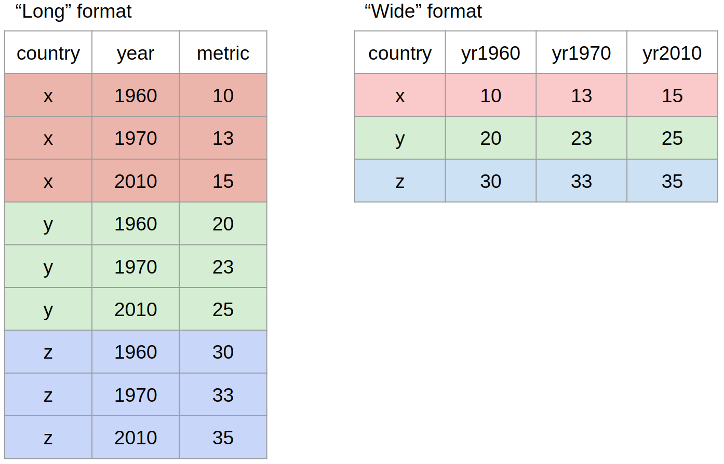
Wide vs. long data format
Wide: Repeated data spread across columns
Long: Repeated data spread across rows

Slide 23
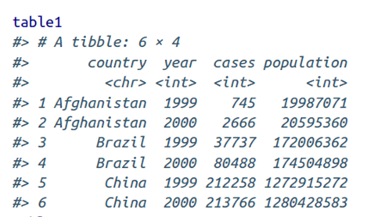
Example tidy Data
*example tables from the tidyverse library

Slide 24
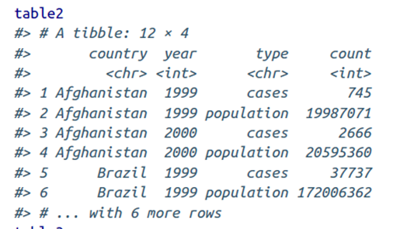
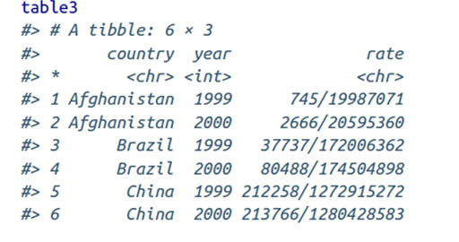
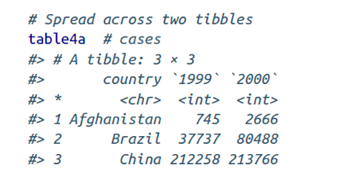
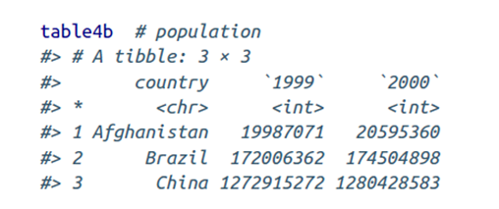
Example untidy Data

Slide 25
Gathering
When trying to reshape wide data to long data
In dplyr, you need to know:
The set of columns that represent values, not variables
The name of the variable whose values form the column names (often referred to as the key)
The name of the variable whose values are spread over the cells (often referred to as the value)

Slide 26
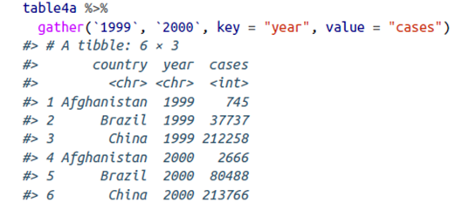
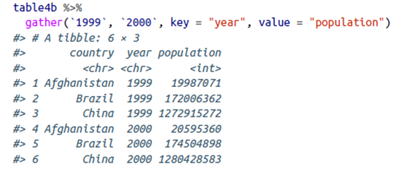
Gathering Examples
Just FYI: pivot_longer() is a newer function in the tidyverse that does similar operations, but with greater functionality

Slide 27
Spreading
Opposite of gathering
Reshaping long data to wide data
In dplyr, you need to know:
The column that contains the variable names (i.e., the key column)
The column that contains the values from the multiple variables (i.e., the value column)

Slide 28
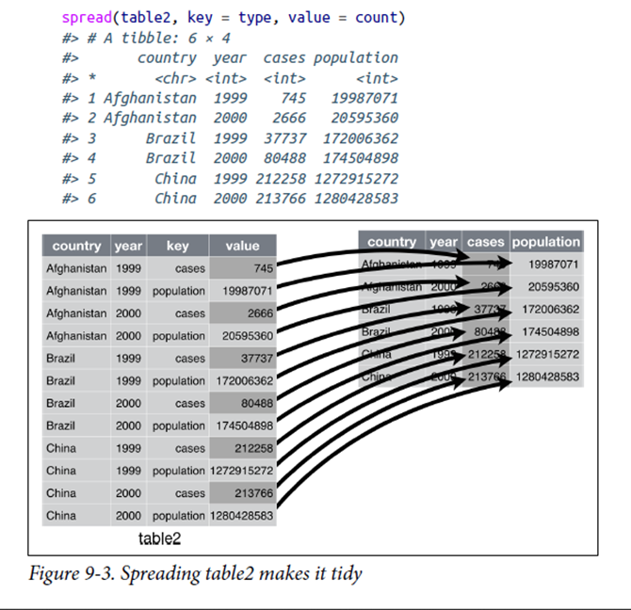
Spreading Example
Just FYI: pivot_wider() is a newer function in the tidyverse that does similar operations, but with greater functionality

Slide 29
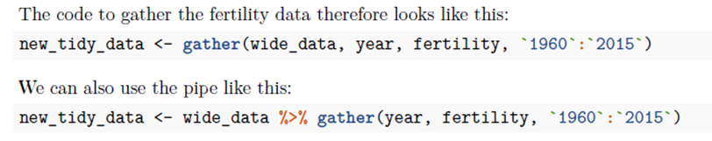
If gathering or spreading more than two columns/rows
You can always supply a range of columns

Slide 30
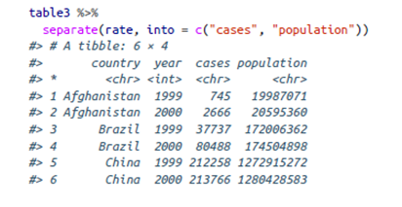
Separating
Splits or pulls apart one column into multiple columns
Based on wherever a separator character appears

Slide 31

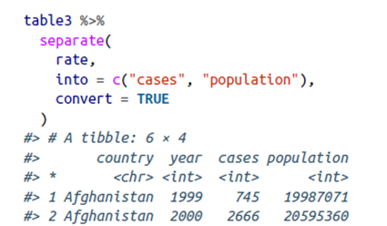
Separating
If you want or need to specify the separator character
separate() leaves the type of the column as is. The type of the new columns could either be coerced later or incorporated into the separate() function with the convert option

Slide 32
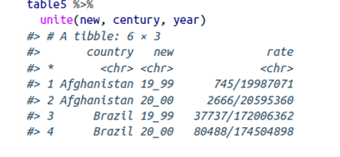
Uniting
Opposite of separating
Combines multiple columns into a single column

Slide 33
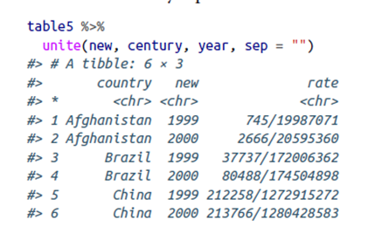
Uniting
As a default, the unite() function will add a _ between the two combined values. The separator argument can control this.
If you want no space:

Slide 34
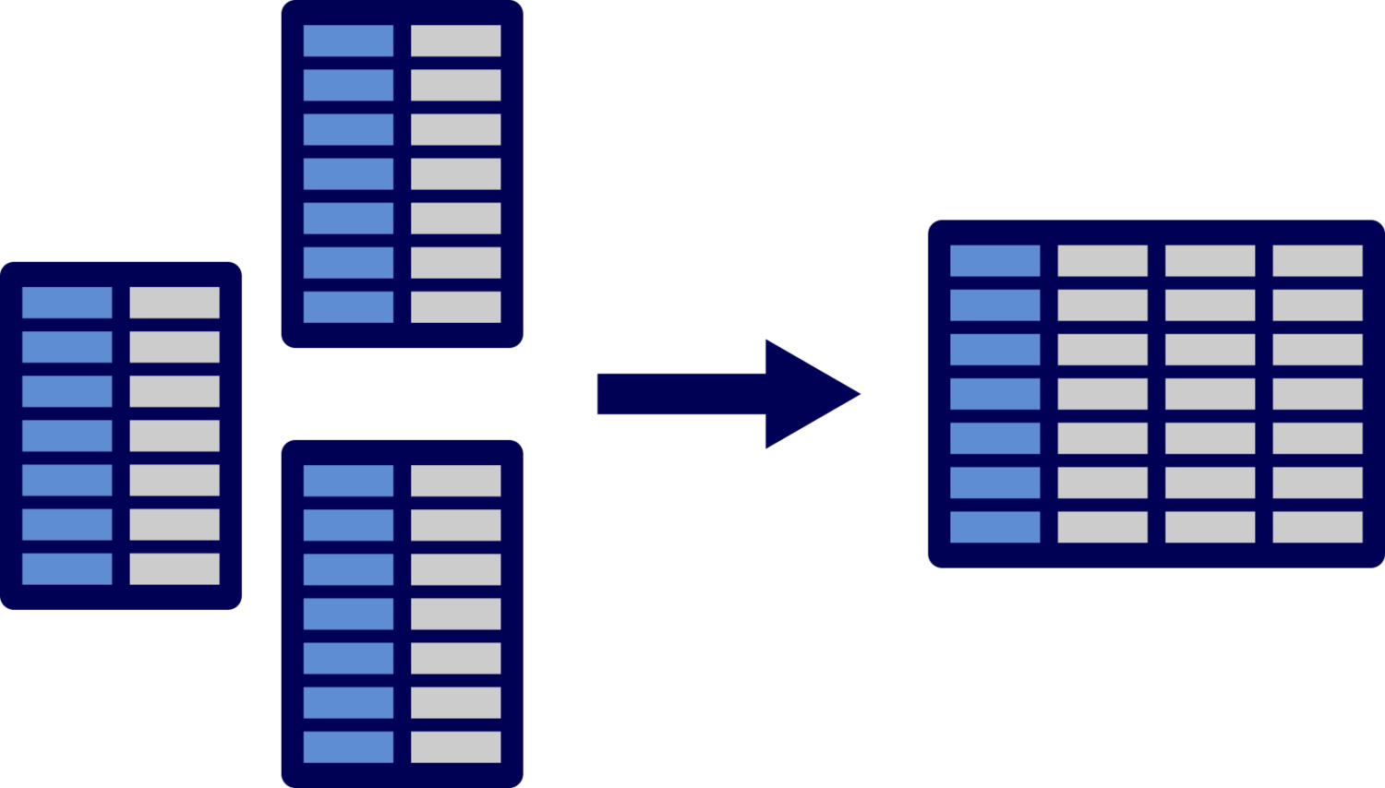
Merging Data

Slide 35
What is data merging?
Combining two or more data sets into a single data set
Adding variables to an existing data set
Adding cases to an existing data set
Combination of both
What are example or experiences you have had with data merging?

Slide 36
Key Variables
Variables that uniquely identify people/observations and can pair people/observations across data sets
Primary key: uniquely identifies an observation in its own data set
Foreign key: uniquely identifies an observation in another data set
Helpful Hints
If a key variable is supposed to be a unique value for each observation, ensure this is the case (e.g., running frequency/descriptive analyses
Ensure that the key variables correspond with one another across data sets

Slide 37
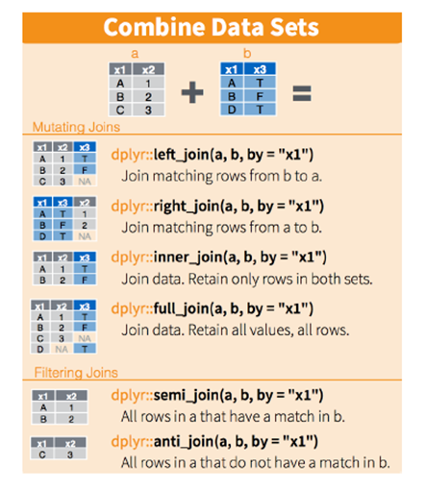
Join Functions in dplyr

Slide 38
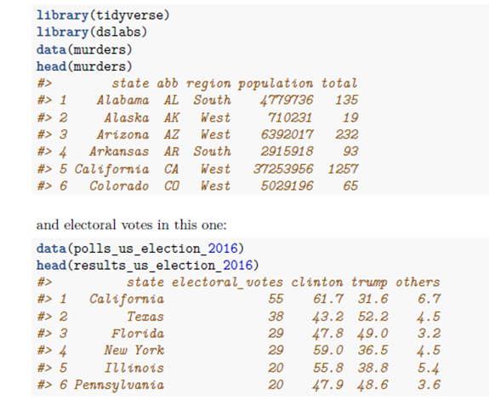
Example from Irizarry (2019)

Slide 39
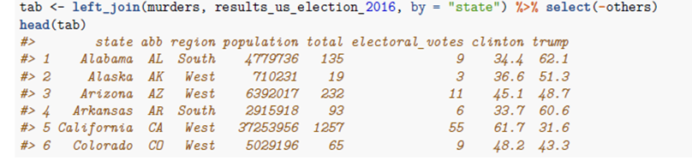
Example from Irizarry (2019)

Slide 40
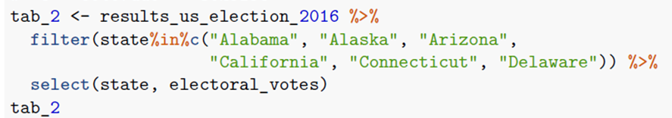
What if the two data sets are of unequal length?
Following the example from Irizarry (2019), let’s create two subsets of the previous two data sets:

Slide 41
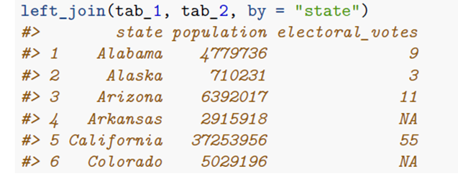
Left Join

Slide 42
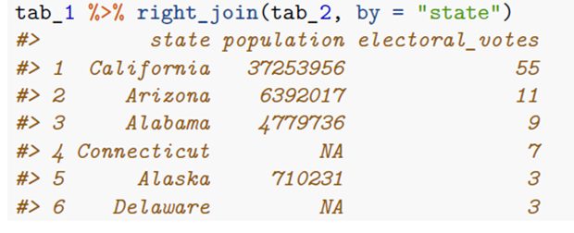
Right Join

Slide 43
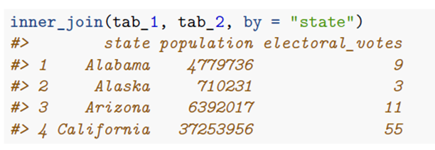
Inner Join

Slide 44
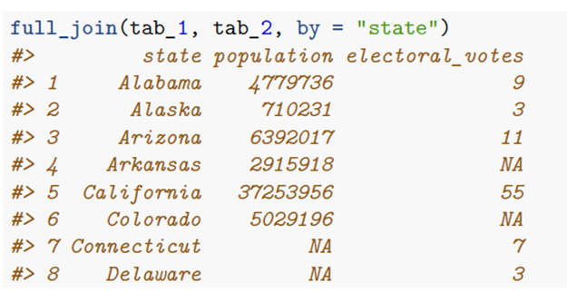
Full Join

Slide 45
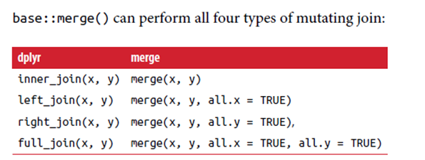
dplyr functions vs. merge()

Slide 46
Key Variables
Make sure there is not any missing data on the key variables (or else the cases will not merge properly)
Always helpful if the key variables across the multiple data sets are named exactly the same
Some statistical software programs require this when merging
If not:
Can always rename the variables to be the same
In dplyr functions, a character vector can be provided: by = c("a" = "b")
Matches variable a in table x to variable b in table y
The variables from x will be used in the output
If no key variable:
Can join based on a unique combination of variables. Example: by = c("year", "month", "day", "hour“)
Be very careful with this method!

